Slide 1
Lab (4) TDR

Slide 2
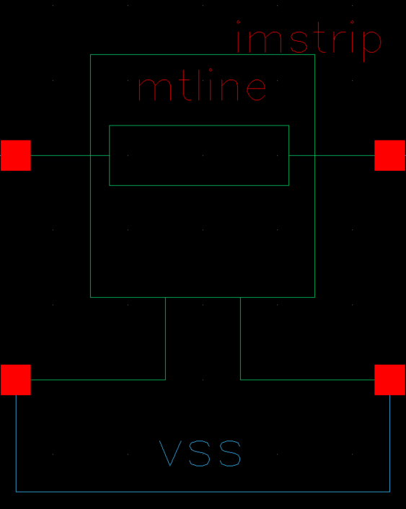
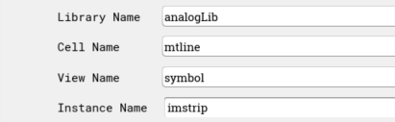
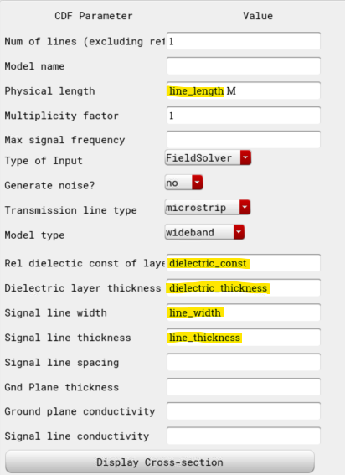
MTLINE Settings
Mtline:
Line_length = 0.15 ➔ For 1ns travel time in transmission line (2ns back & forth)
Dielectric_const = 4.8
Dielectric_thickness = 360u
Line_width = 625um
Line_thickness = 17.78u
For Zo = 50 Ohms

Slide 3
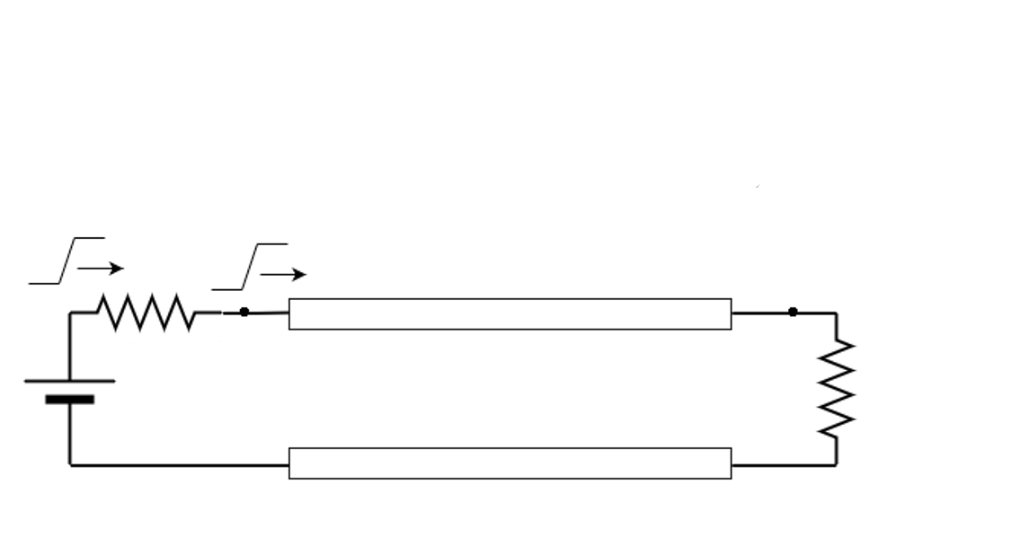
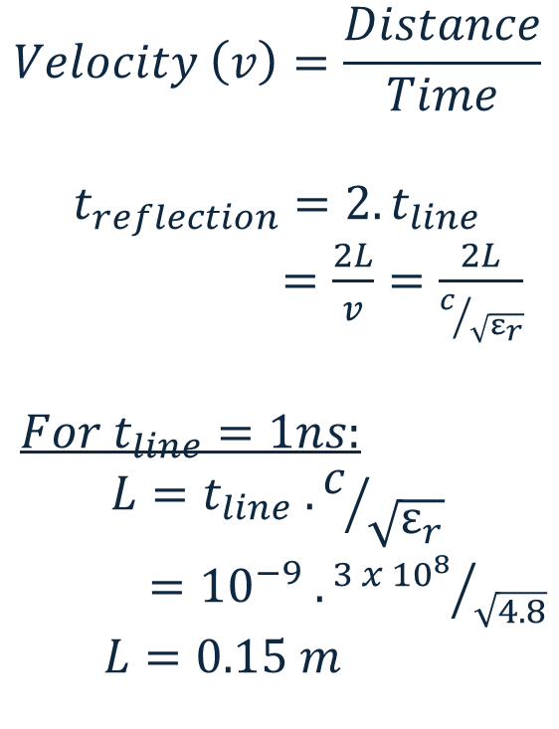



Relationship between Length of transmission line & time taken for pulse to travel in the transmission line
$$Velocity \left(v\right)=\frac{Distance}{Time}$$
$$t_{reflection}=2.t_{line}$$
$=\frac{2L}{v}=\frac{2L}{c/{\sqrt{ε_{r}}}}$
$For t_{line}=1ns:$
$$L=t_{line} .c/{\sqrt{ε_{r}}}$$
$={10}^{−9} . {3 x {10}^{8}}/{\sqrt{4.8}}$
$$L=0.15 m$$
$$v$$
$t_{line}=1ns$
$$L$$

Slide 4
(A) Resistive Loads

Slide 5
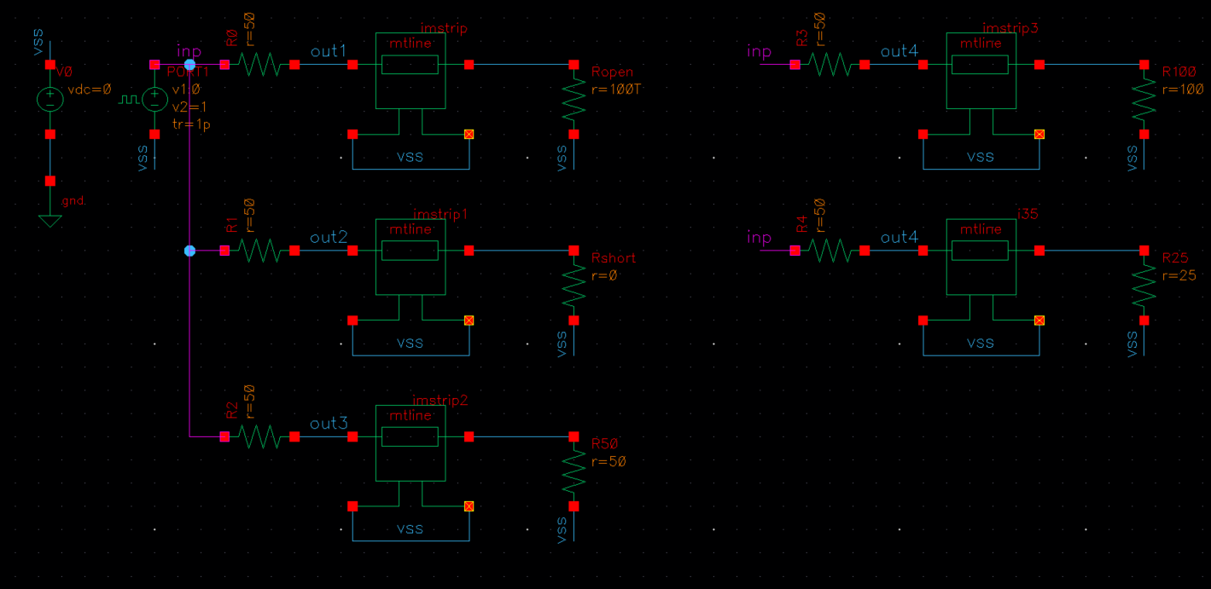
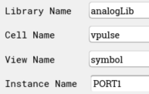

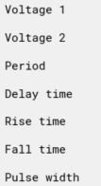

TB1: Transient
Zo=100
Open
Zo=25
Short
Zo=50

Slide 6
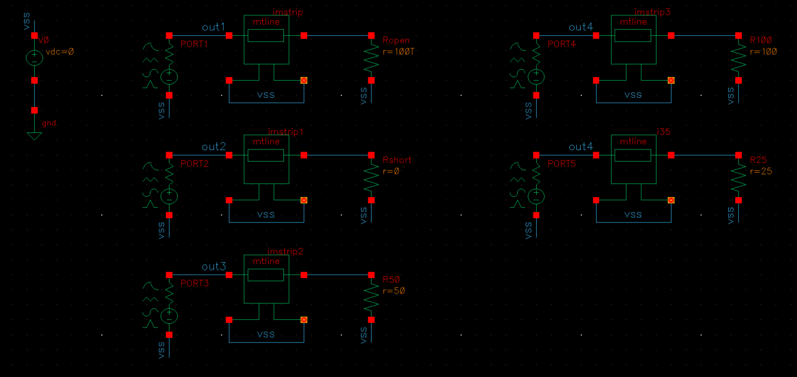
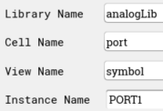
TB2: S-Parameters
Zo=100
Open
Zo=25
Short
Zo=50

Slide 7
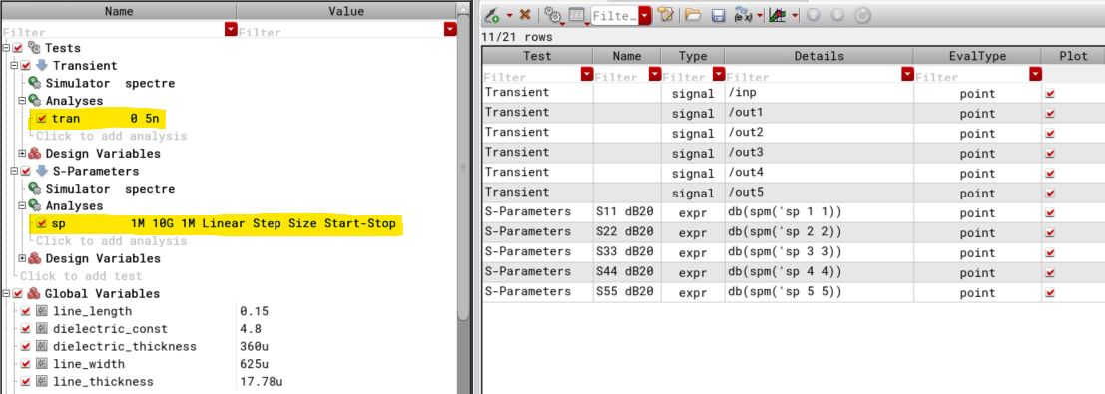
Analyses Setups

Slide 8
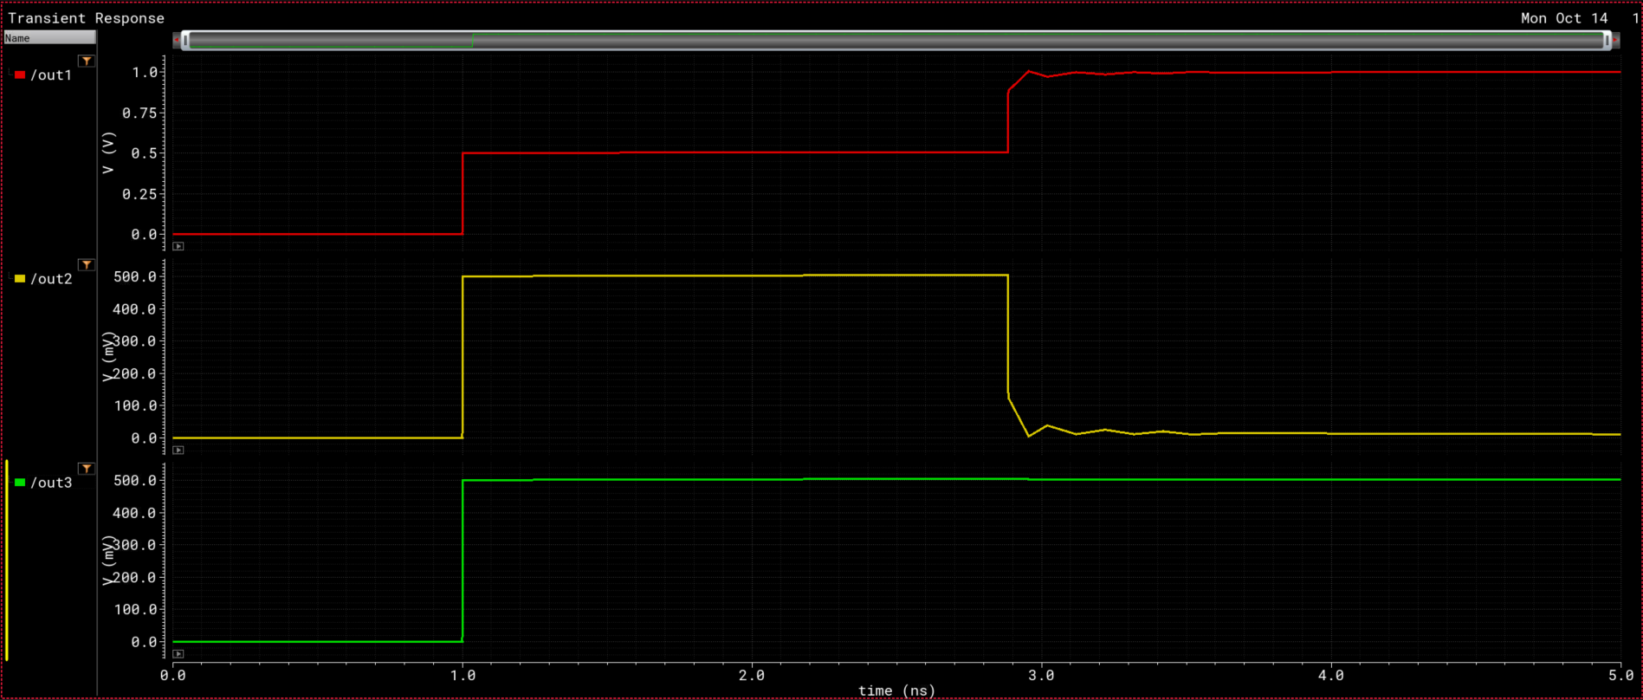
Results (Transient)
1
0.5
Open
0
0.5
Short
1.8ns (not exactly 2ns)
0
0
0.5
ZL = 50
(Matched)
0

Slide 9
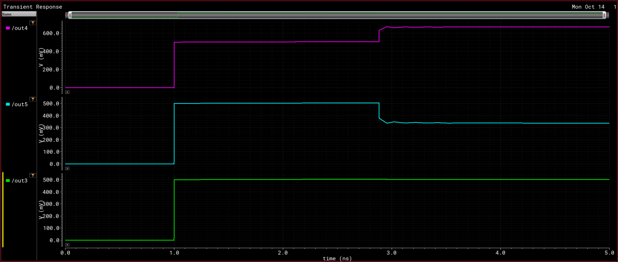
Results (Transient)
0.5
0.667
ZL = 100
0
0.5
0.339
ZL = 25
0
0.5
ZL = 50
(Matched)
0

Slide 10
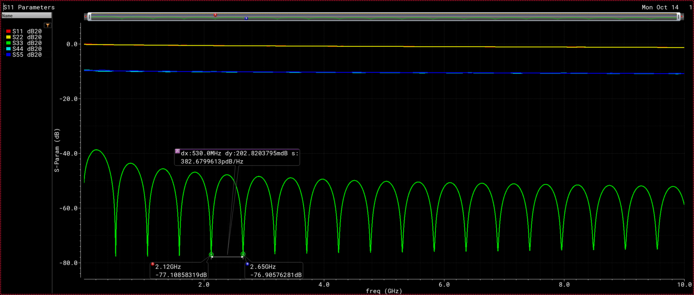
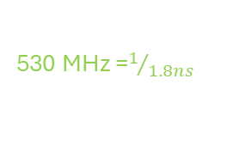
Results (S-Parameters) – S11
ZL = Open & Short
ZL = 25 & 100
530 MHz =$1/{1.8ns}$
ZL = 50
(Matched)

Slide 11
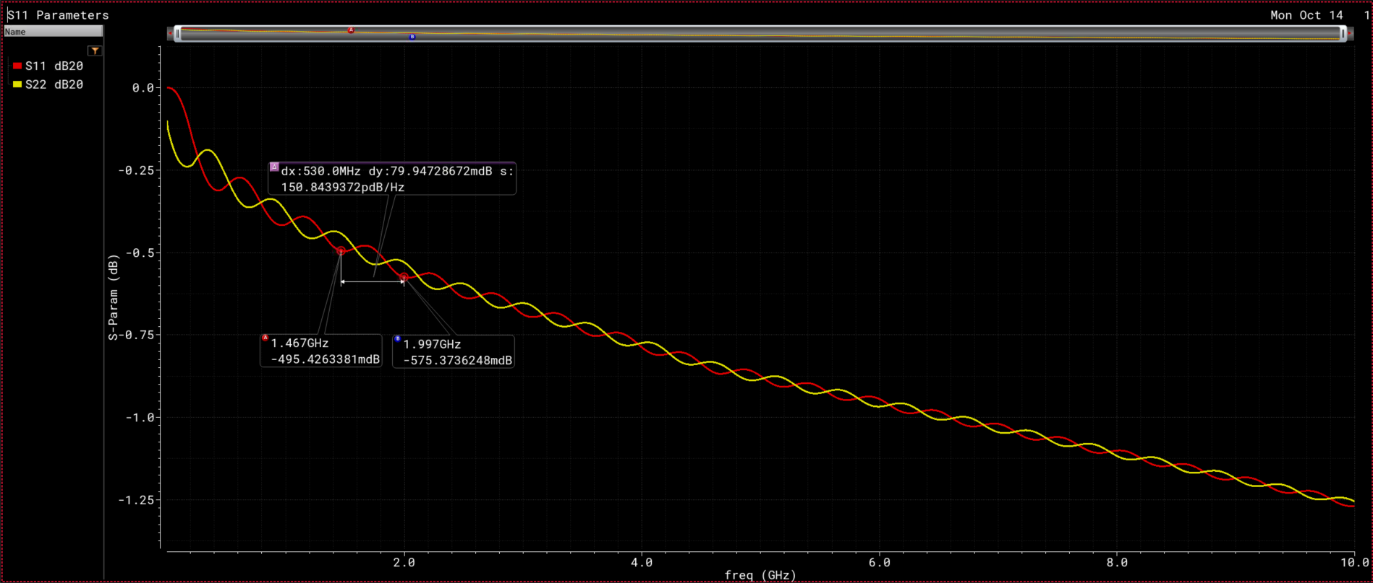
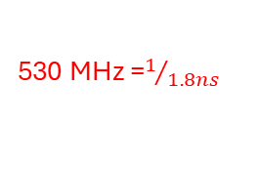
Results (S-Parameters) – S11
530 MHz =$1/{1.8ns}$
S11 (ZL=Open)
S11 (ZL=Short)

Slide 12
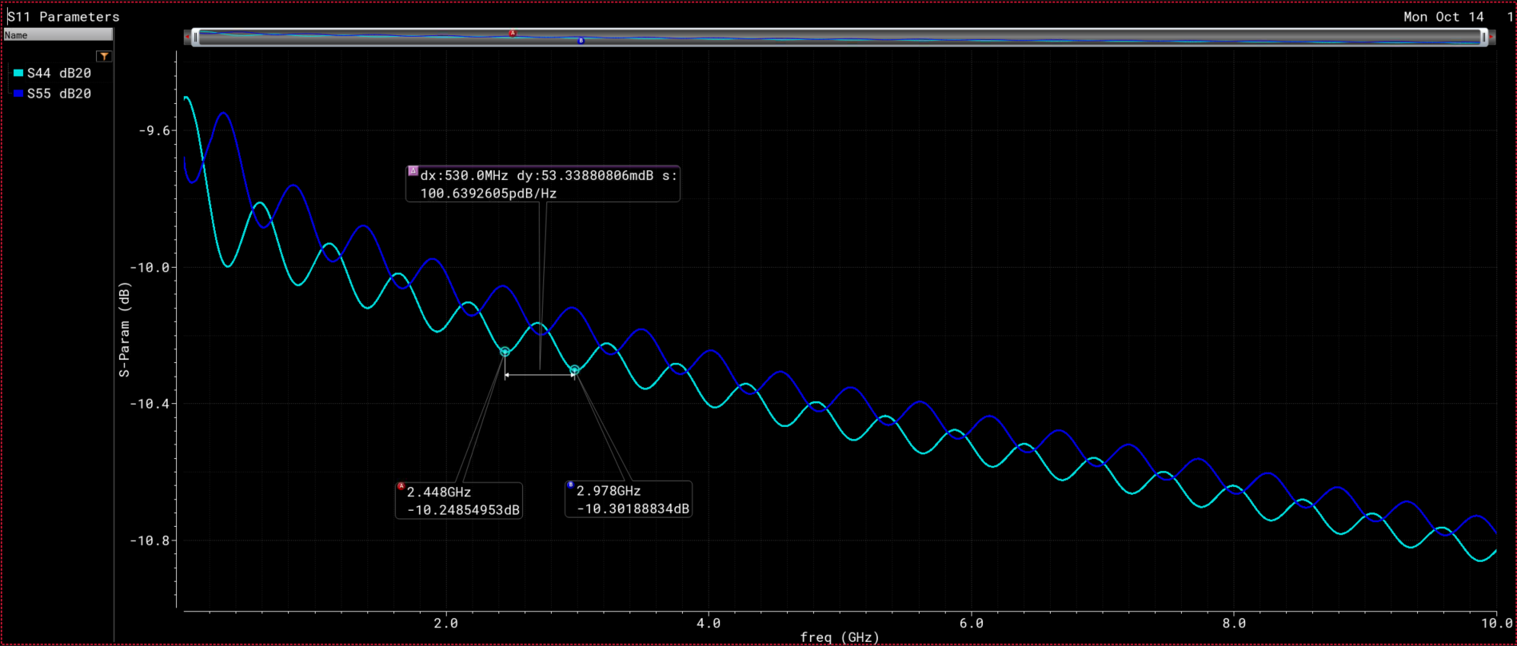
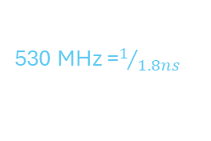
Results (S-Parameters) – S11
530 MHz =$1/{1.8ns}$
ZL = 25
ZL = 100

Slide 13
(B) Inductive & Capacitive Loads

Slide 14
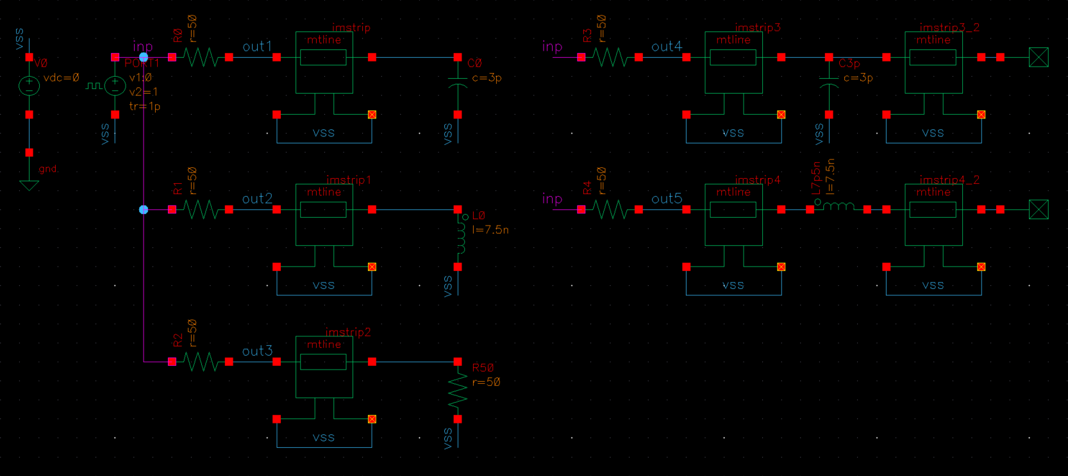
TB1: Transient
Cap + 50Ohm
Capacitor
Ind + 50Ohm
Inductor
Zo=50

Slide 15
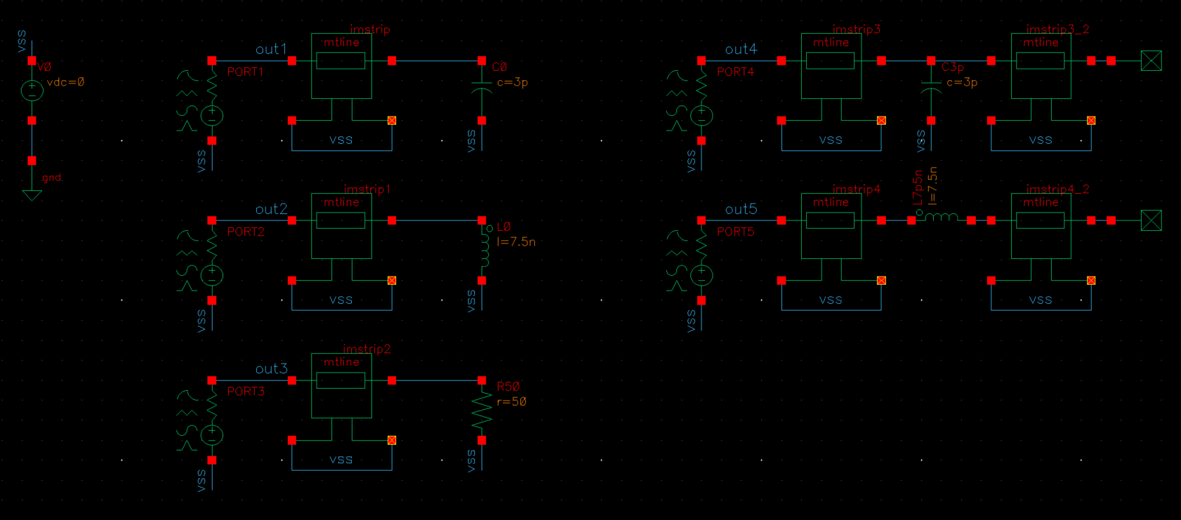
TB2: S-Parameters
Cap + 50Ohm
Capacitor
Ind + 50Ohm
Inductor
Zo=50

Slide 16
Analyses Setups

Slide 17
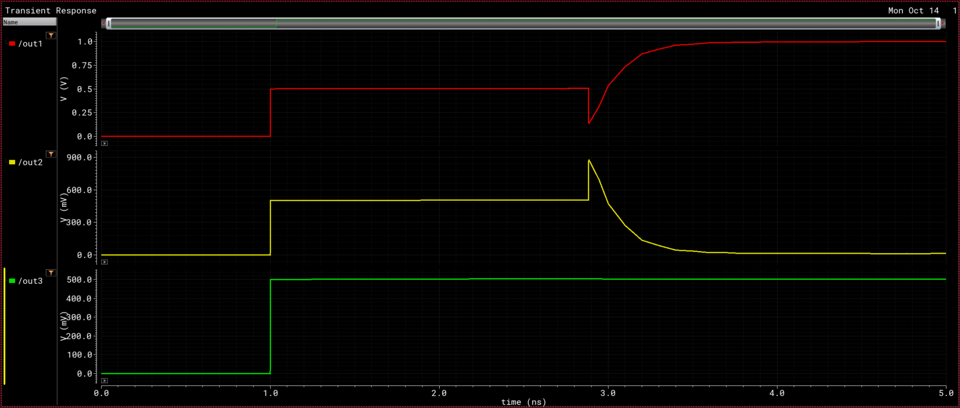
Results (Transient)
1
0.5
Capacitor
0
0.5
Inductor
0
0
0.5
ZL = 50
(Matched)
0

Slide 18
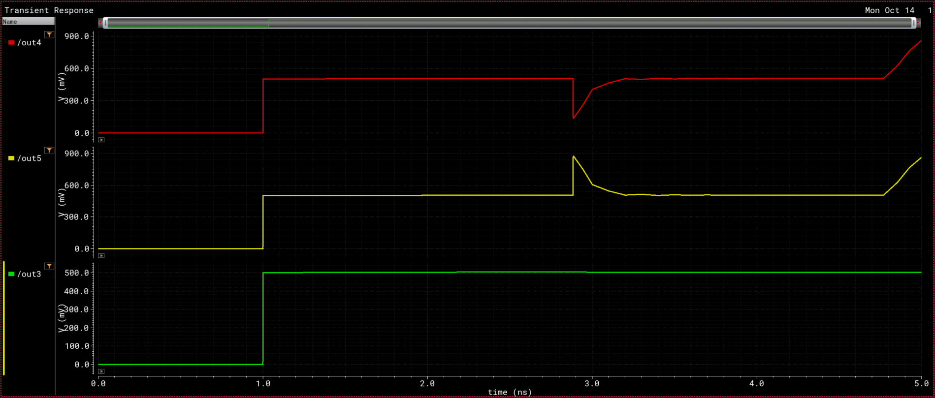
Results (Transient)
0.5
0.5
Capacitor + 50 Ohm
0
0.5
0.5
Inductor + 50 Ohm
0
0.5
ZL = 50
(Matched)
0

Slide 19
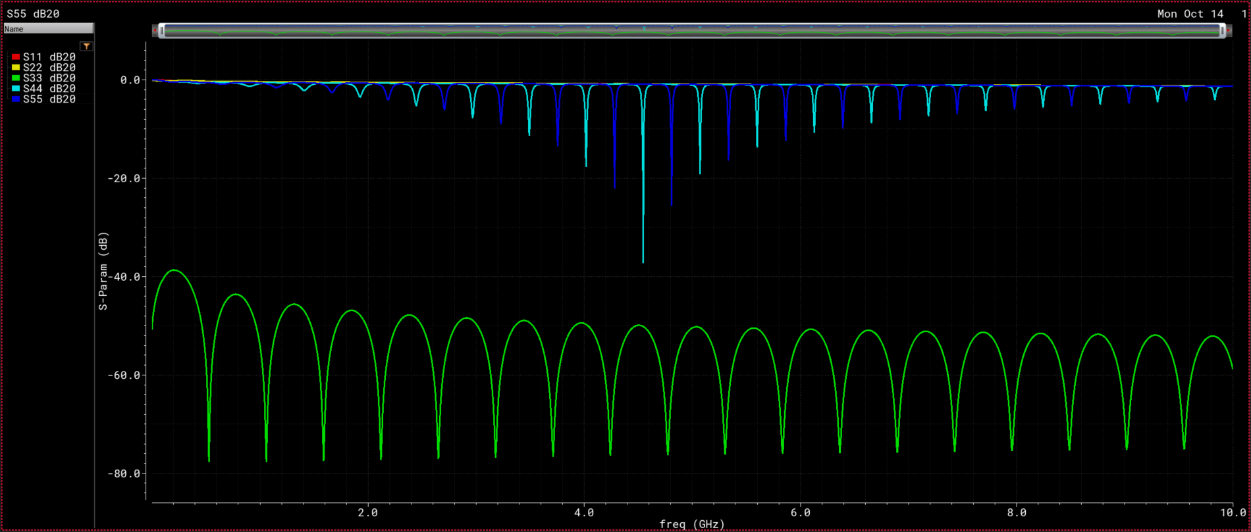
Results (S-Parameters) – S11
ZL = Cap & Ind
ZL = Cap + 50Ohm & Ind + 50Ohm
ZL = 50
(Matched)

Slide 20
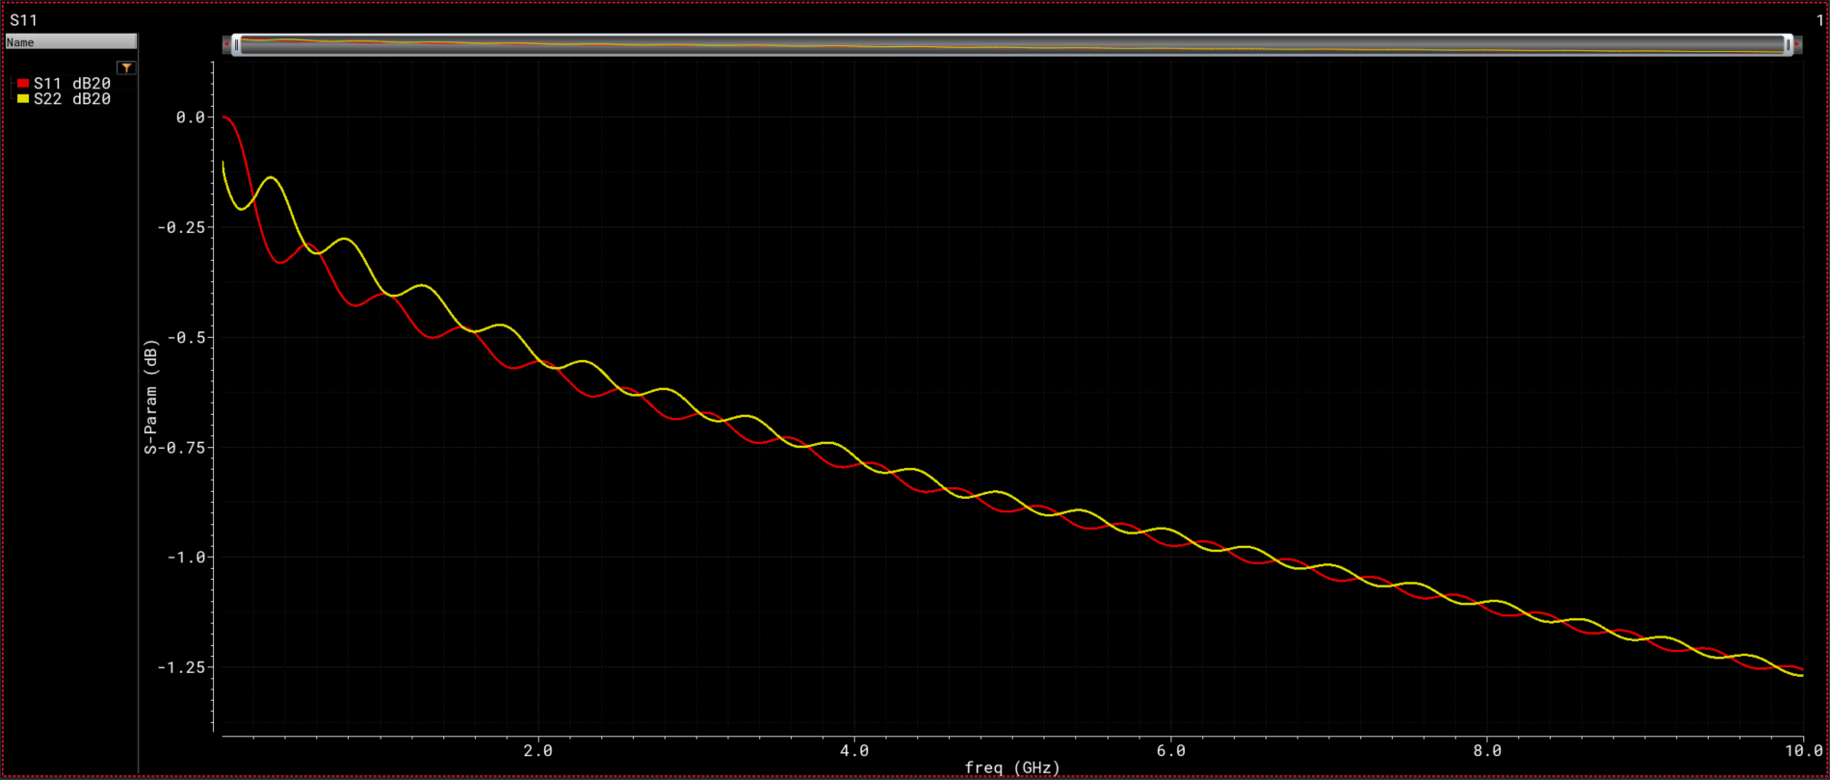
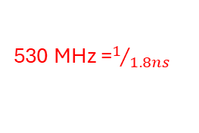
Results (S-Parameters) – S11
530 MHz =$1/{1.8ns}$
S11 (ZL=Cap) ➔ Similar to Open
S11 (ZL=Ind) ➔ Similar to Short

Slide 21
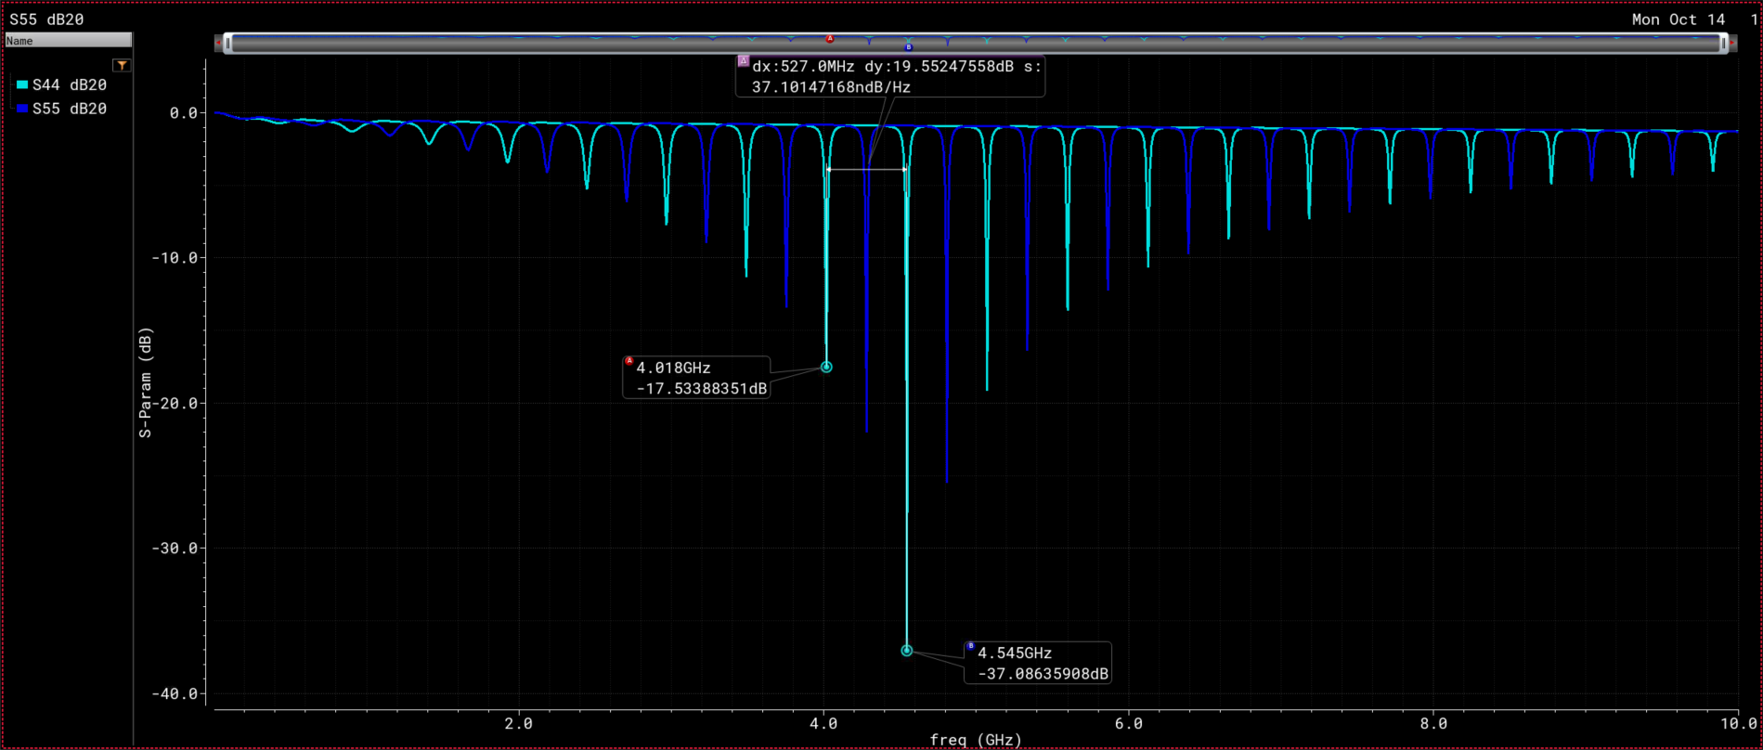
Results (S-Parameters) – S11
ZL = Cap + 50Ohm
ZL = Ind + 50Ohm
~ 530 MHz

Slide 22
(C) LC Network Loads

Slide 23
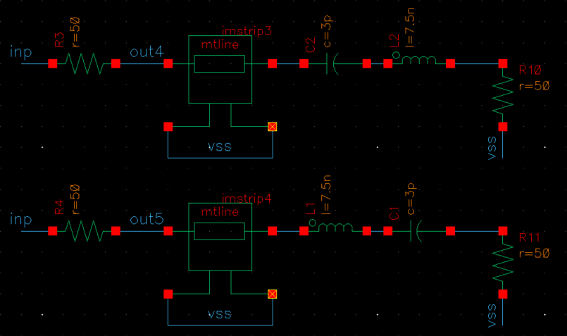
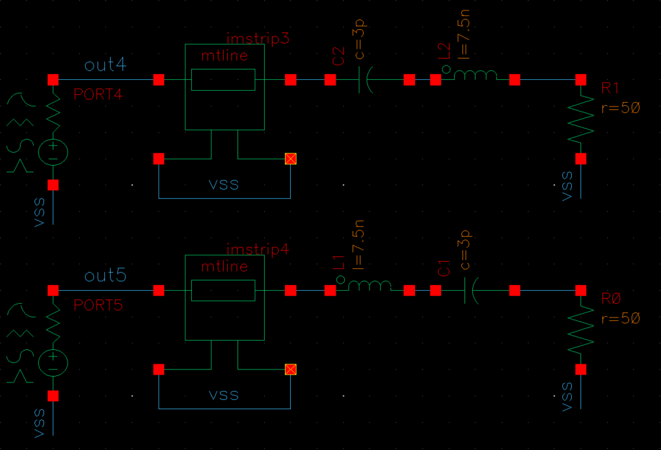
TB1: Transient
[1] Series LC network
TB2: S-Parameters

Slide 24
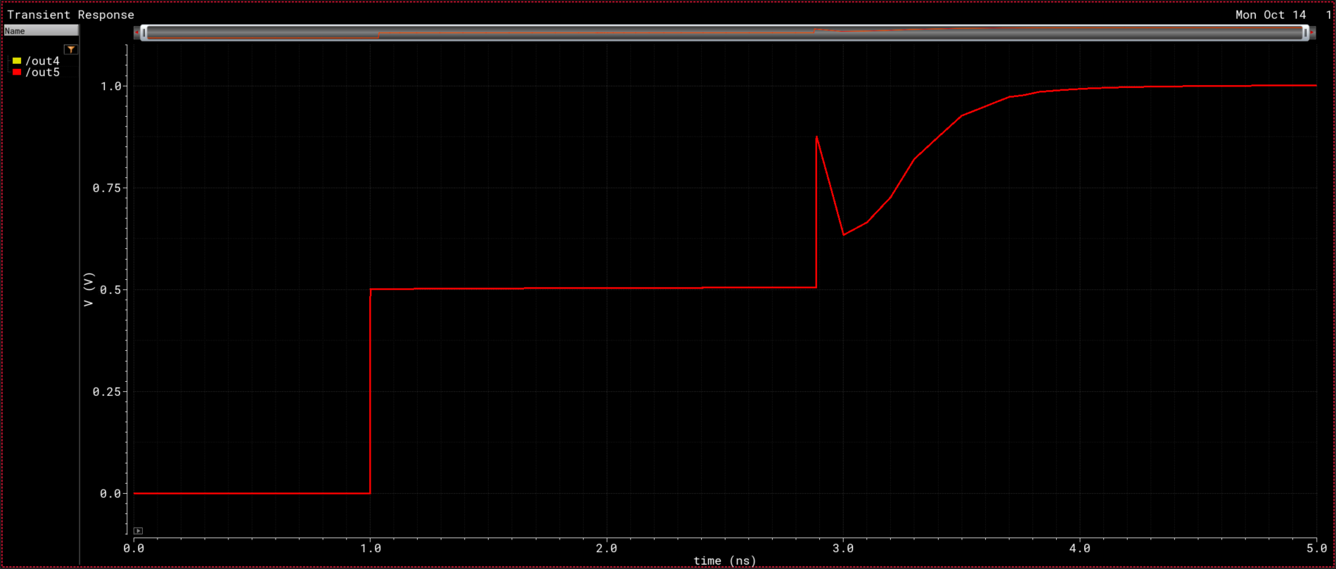
Results (Transient)
1
Series LC Network
0.5
0

Slide 25
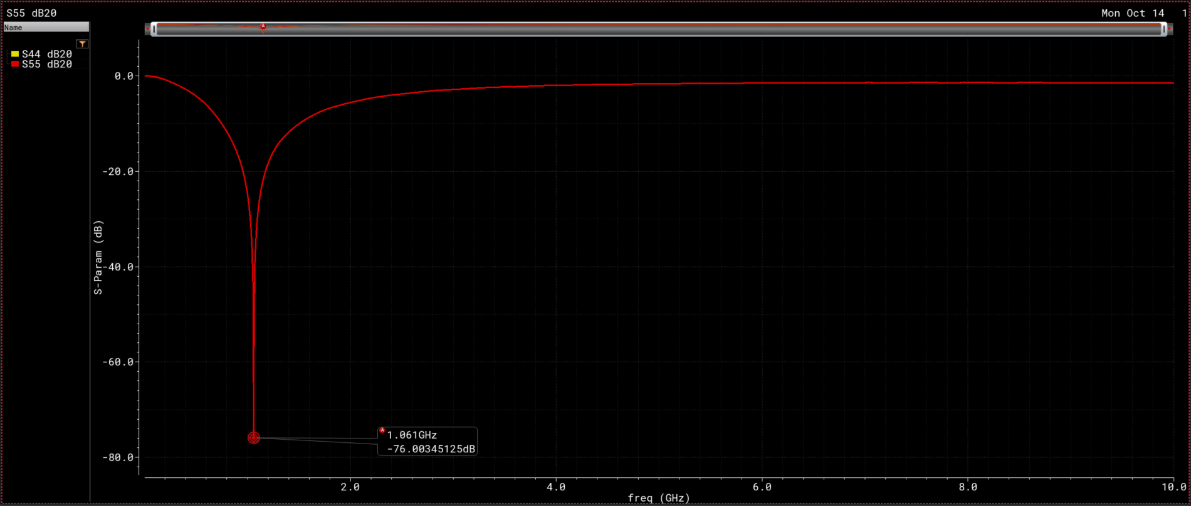

Results (S-Parameters) – S11
Series LC Network
$freq_{res}$=$\frac{1}{2π\sqrt{LC}}=\frac{1}{2π\sqrt{7.5n x 3p}}=1.061 GHz$

Slide 26
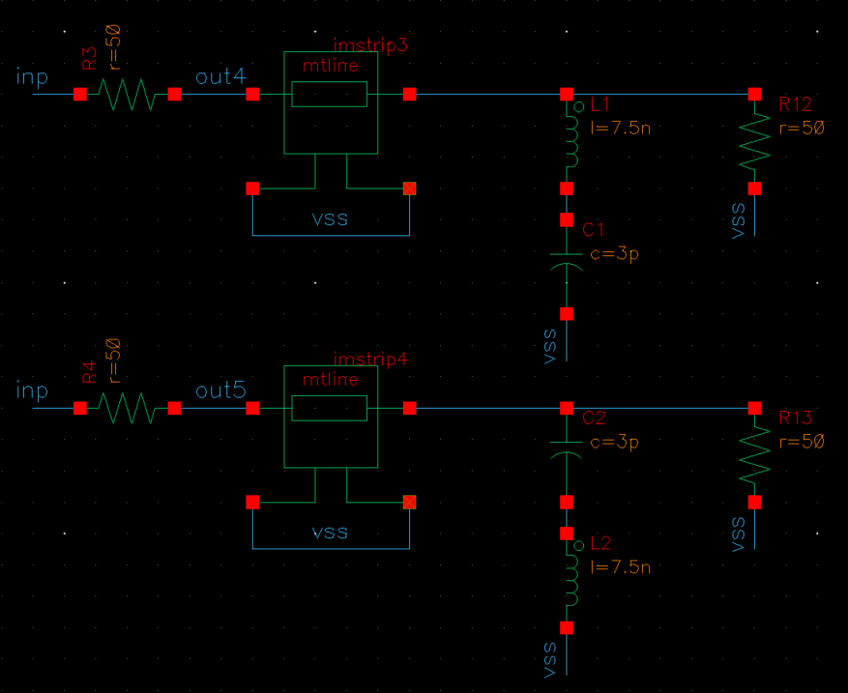
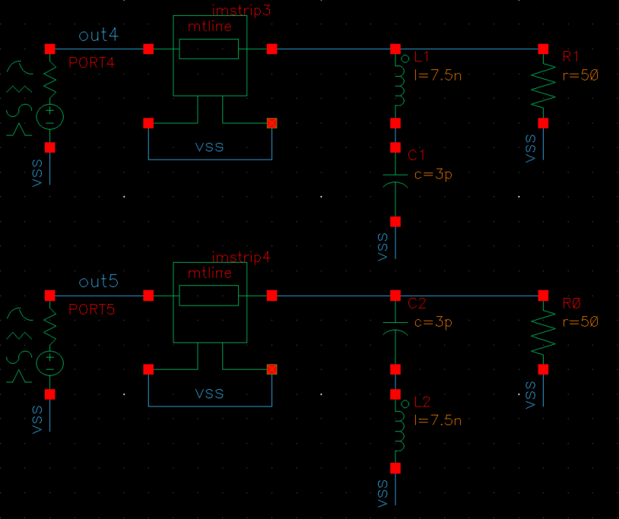
TB1: Transient
[2] Parallel LC network
TB2: S-Parameters

Slide 27
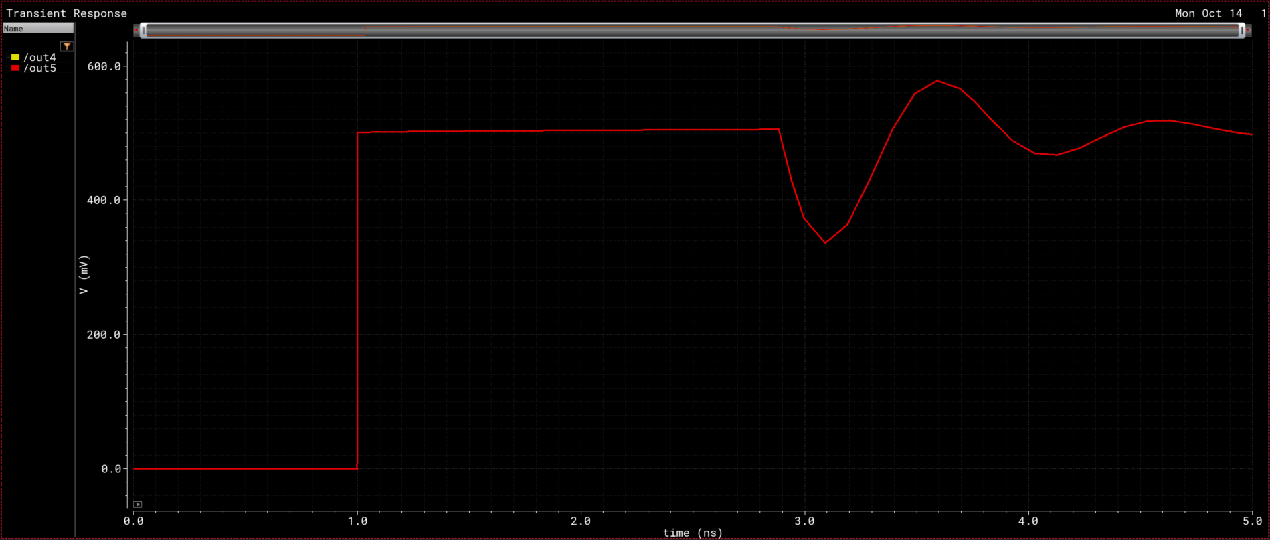
Results (Transient)
0.5
0.5
Parallel LC Network
0

Slide 28
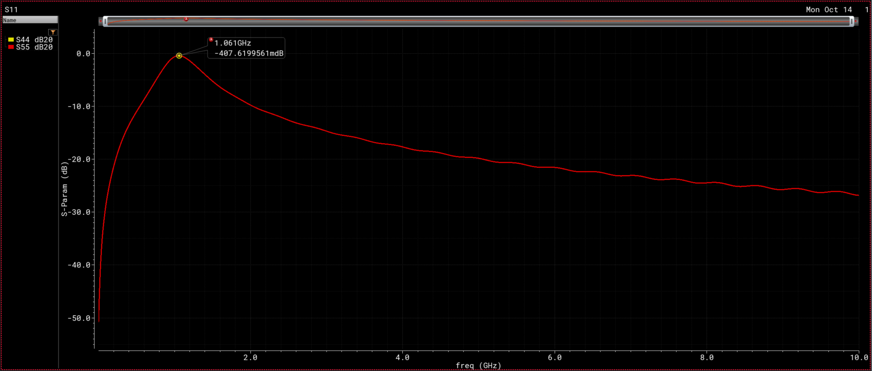

Results (S-Parameters) – S11
$freq_{res}$=$\frac{1}{2π\sqrt{LC}}=\frac{1}{2π\sqrt{7.5n x 3p}}=1.061 GHz$
Parallel LC Network

